Slide 1
POPORROS TOURS
Proyecto #1 de programación básica

Slide 2
POPORROS TOURS TEAM
DAYAN STEVEN GARCIA PEREZ (CODE DESIGNER – DISEÑADOR CODIGO)
FABIAN GAMBOA (CODE DESIGNER – DISEÑADOR CODIGO)
GEIDER DAVID PARALES (WEB DEVELOPMENT – DESARROLLADOR PAGINA WEB)
JULIAN ANDRES MONTOYA (TESTER – QUIEN HACE PRUEBA DE CODIGO)

Slide 3
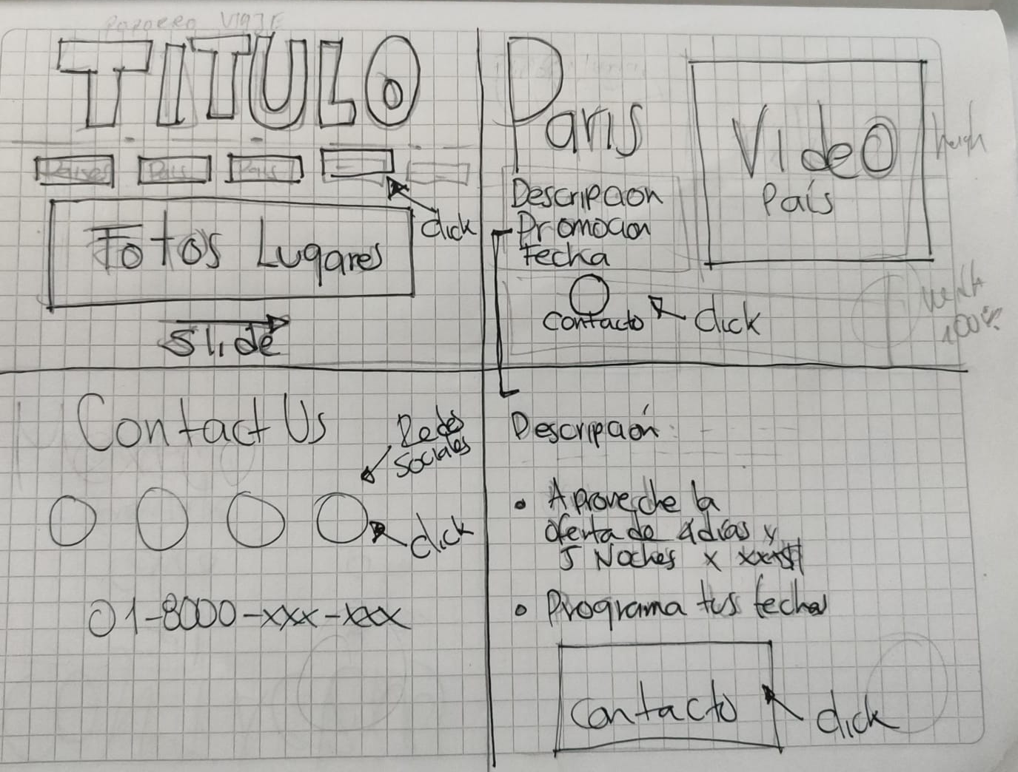
PAGE SKETCH

Slide 4
OBJECTIVES
Create an interactive page.
Use the knowledge learned in class.
Create a document with the codes generated.

Slide 5
PROJECT SCOPE
Create a simple travel website using HTML and CSS to showcase popular destinations, travel tips, and a photo gallery.
Features
Home Page: Introduction and navigation links.
Destinations Page: List of popular destinations with descriptions and images.
Gallery Slide: Grid of images from various destinations
Contact Page: Form for user inquiries (name, email, message).
Technical Requirements
Use HTML for content structure.
Use CSS for styling and responsive design.

Slide 6
PROJECT SCOPE
Timeline
Week 1: Basic HTML structure, CSS styling.
Week 2: Navigation and responsiveness, final testing and adjustments.
Deliverables
Complete website with HTML and CSS files, featuring a user-friendly interface.
This project will establish foundational skills in HTML and CSS while creating an engaging travel site.

Slide 7
USED TECHNOLOGIES
Visual Studio Code
HTML
CSS
Fonts Google
Awesome Fonts
GitHub

Slide 8
WHAT WE LEARNED
Visual Studio Code
Basic GitHub
Basic HTML
Basic CSS
Create basic websites
Useful libraries where to find code information

Slide 9
CHALLENGES
Introduce new codes to the website in order to make it more interactive.
Using grid and flex to divide the website correctly as planned.
Connect the codes made by all the group.

Slide 10
RECOMENDATIONS
Try to have more practice doing basic html coding in the class, with the advice of the course teacher.
Reinforce the learning of the tags used for inserting images, moving images, changing fonts, inserting hyperlinks.
Integrate more in group activities with classmates to level up in the basic knowledge of HTML, about the VS Code application, CSS, and CSS.

